Slide 1
Remote sensing of cyanobacterial blooms in a hypertrophic lagoon using multitemporal Sentinel-2 images

Slide 2
Objectives of the study
Develop a method or an algorithm well calibrated to estimate cyanobacteria density variation and spatial.
Evaluate the performance of the algorithm ( accuracy) with observed data ( validation).
Verify the correspondence between cyanobacteria density and World Health Organisation policies.
Establish a protocol for regular and frequent monitoring and understand the link between cyanobacteria ( phycocyanin) growth and climate change, precipitation, human influence etc.

Slide 3
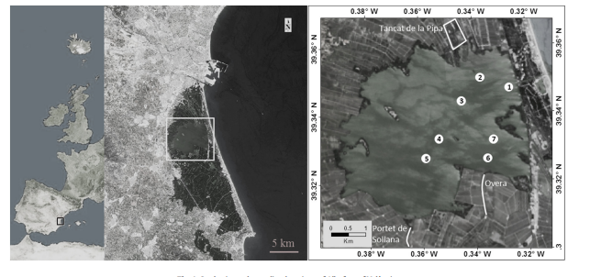
Data collected from seven different places within the lagoon ( picture below).
Site on interest: Albufera lake in Valencia ( Spain).
(Albufera of València, Eastern Iberian Peninsula)
Retrieval algorithm: a satellite reflectance algorithm for estimating cyanobacterial total biovolume.
Datasets:
76 georeferenced samples were collected at 0.2 m depth.
Training or calibrating set : 21
Validating : 55

Slide 4
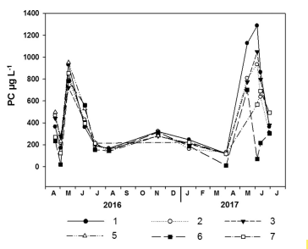
Observed data
PC: phycocyanin density
retrace the evolution of the phycocyanin density in the period of 2 years for each region of the 7.
minimums and maximums due to flooding rate and precipitation
Temporal variations of the measured data in the campaigns for each sample point

Slide 5
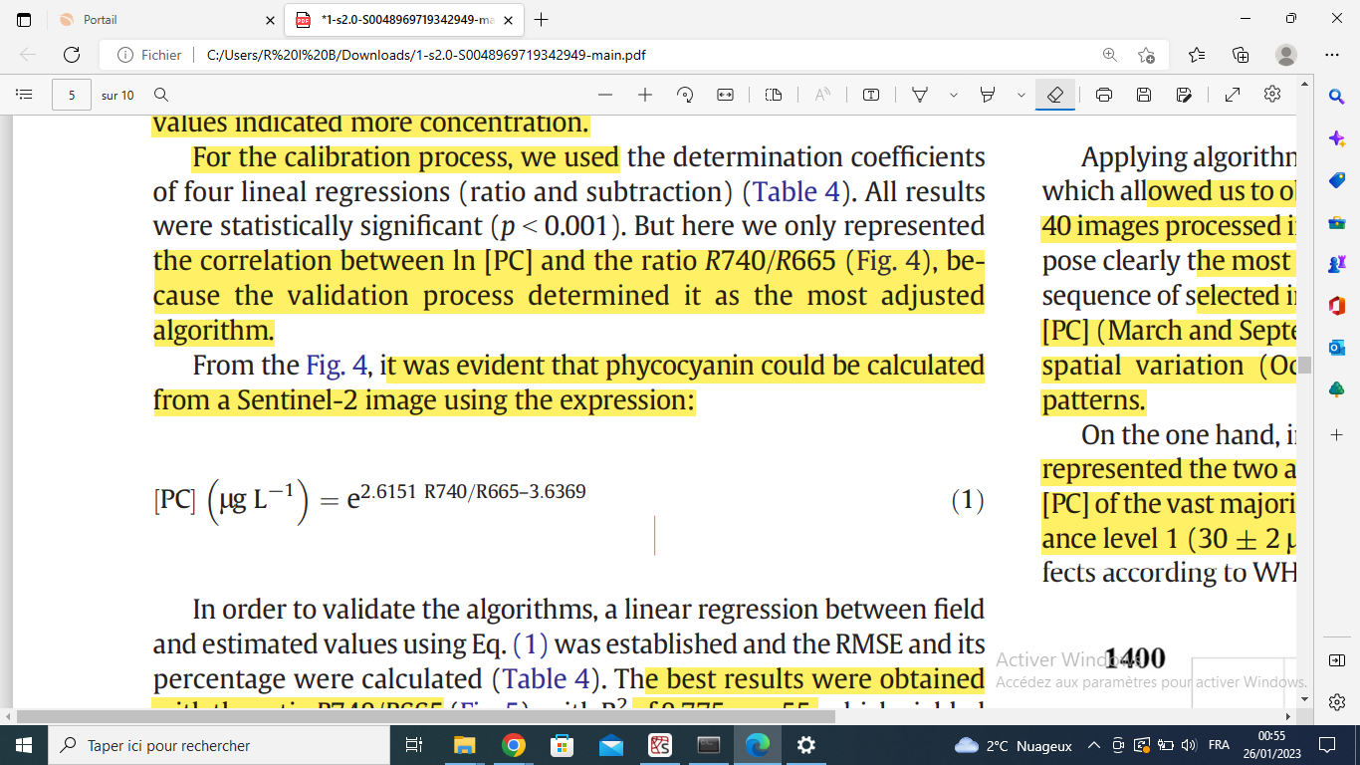
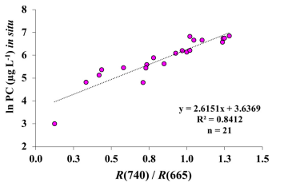
Retrieval algorithm:deriving a regression model for operations with bands.
Absorption of phycocyanin is centred at 620 nm, while the absorption on the 709 and 779 nm bands is assumed to be dominated by water alone.
Fitting the model
Exponential regression
lnPC : logarithm of phycocyanin density.
R740 ( R665): Absorbance of the wave length 740 nm ( respectively 665 nm).
RMSE=40%
R²=0.775

Slide 6
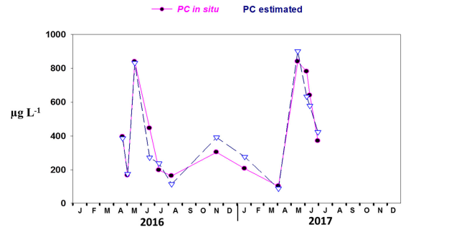
After calibrating and validating
For each day, for the observed data, we calculate the mean of algal concentration over all regions.
PC in situ : observed data for algal density.
PC estimated : predicted data after calibration.

Slide 7
Applications of this study

Slide 8
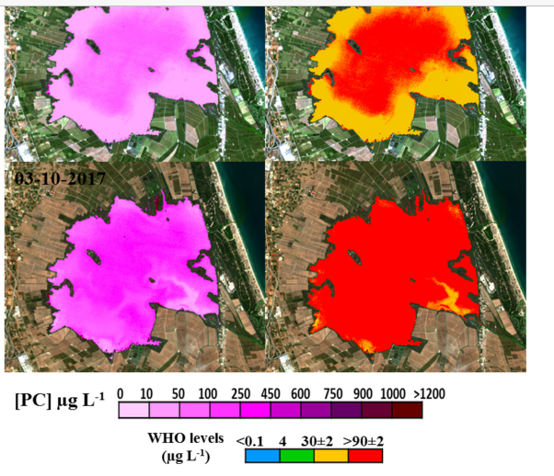
Understand the correlation between Phycocyanin concentration and natural phenomenon: precipitation, climate change, human action
Follow in real time algal density variations and assess them under WHO policies.
canal for water renewal

Slide 9
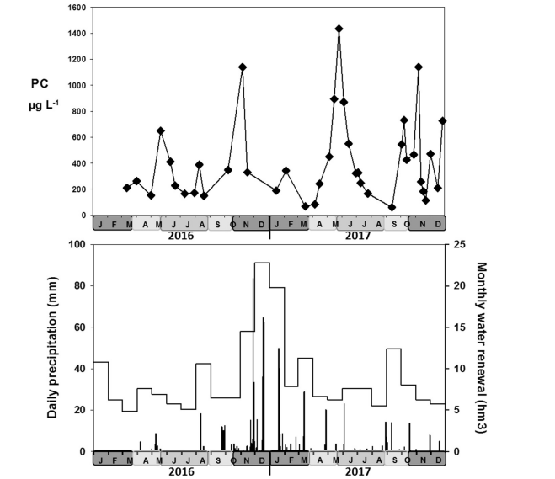
Link between water floodings ( rice paddies), precipitations, water renewal and Phycocyanin concentration variations.

Slide 10
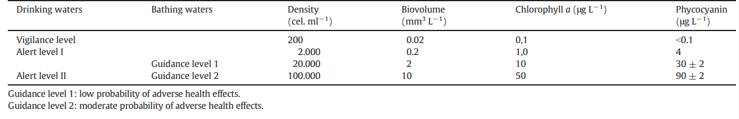
WHO ( World Health Organisation) surveillance limits
High algal density ( phycocyanin) may cause health problems and affect aquatic life.
The developed algorithm permits a real-time monitoring in order to predict if phycocyanin concentration would reach alert levels.

Slide 11
Feedback for our case
Follow the same methodology in our study : analyse observed data, establish a correlation between severity and other variables and test the correlation.
Focus on absorbance wavelength as a key feature in severity classification ( or wavelength bands).
Not to ignore density : density variation rhythm between two dates may vary between two types of Algal blooms having different severity.
=> severity may be a function of the derivative of density. ( Problem : severity is not a continuous function ( only 5 different values ranging from 1 to 5).

